Slide 1
WHO MOVED MY CHEESE

Slide 2
SCENE 1 NEAR CONSTRUCTION SITE

Slide 3
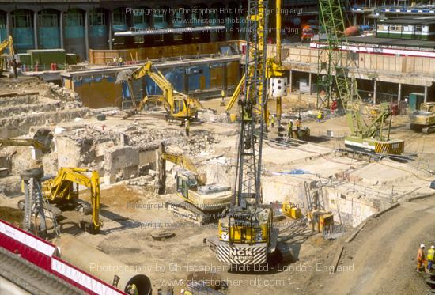

Slide 4
SCENE 2 RUNNING FROM THE CONTRATOR

Slide 6
SCENE 3 MEETING THE RICH KID

Slide 7
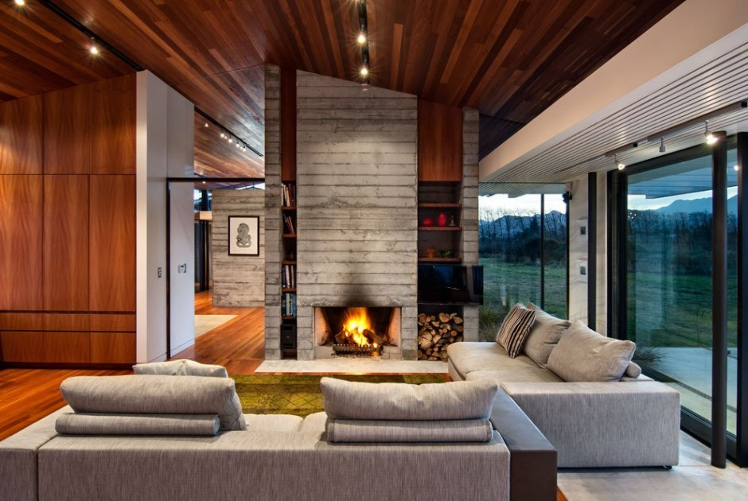
INSIDE RICH KIDS HOUSE

Slide 8
SCENE 4 GOING TO THE SCHOOL

Slide 9
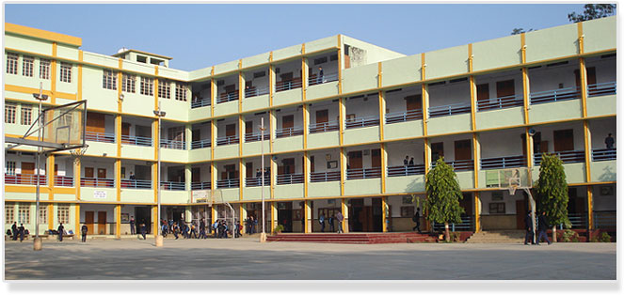

Slide 10
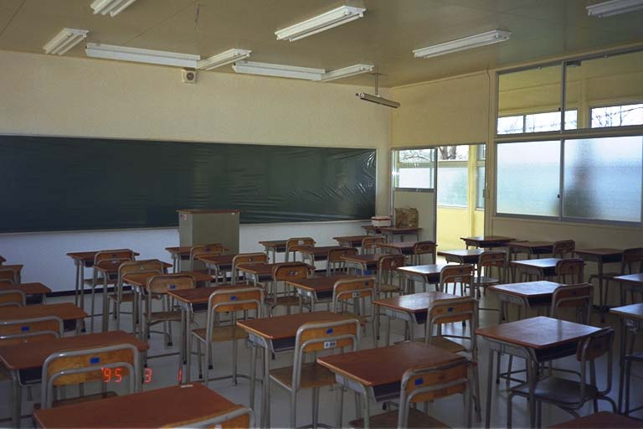

Slide 11
AFTER 10 YEARS

Slide 12
SCENE 5 INTERVIEW

Slide 13
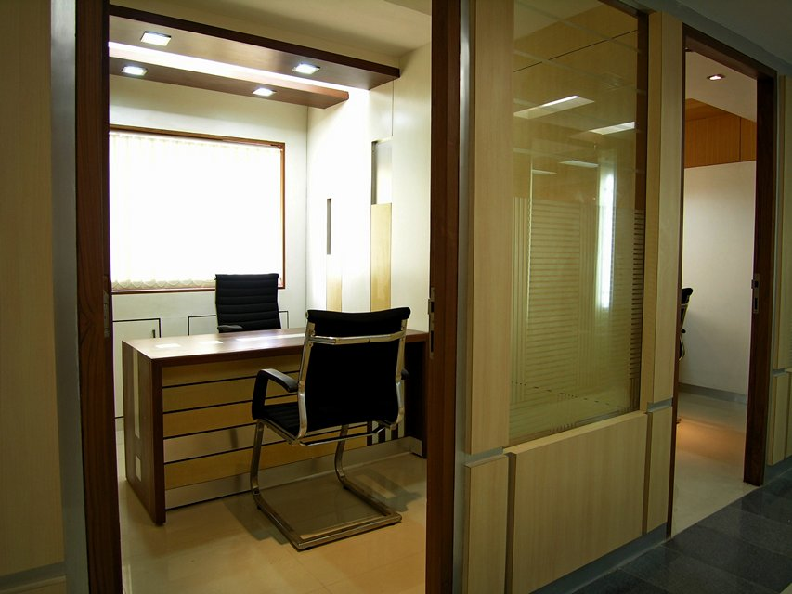

Slide 14
AFTER THREE MONTHS

Slide 15
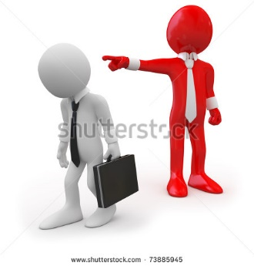
BOTH OF THEM GOT FIRED FROM THE OFFICE

Slide 16
SCENE 5 setting up new companies

Slide 17
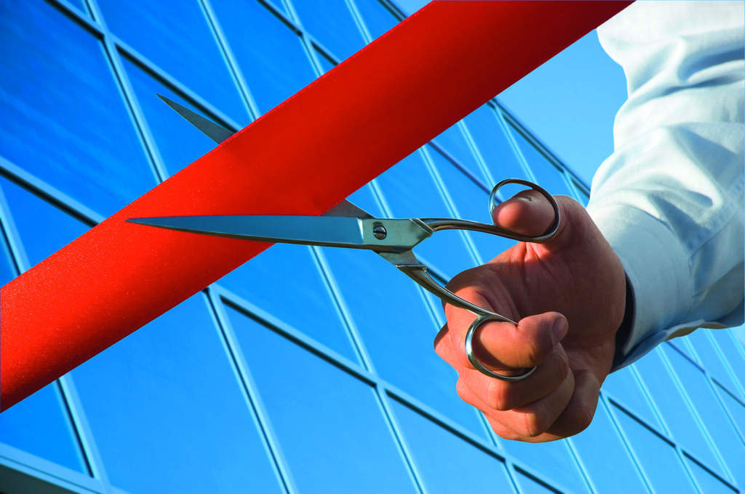

Slide 18
SCENE 6 in the hospital

Slide 19


Slide 20
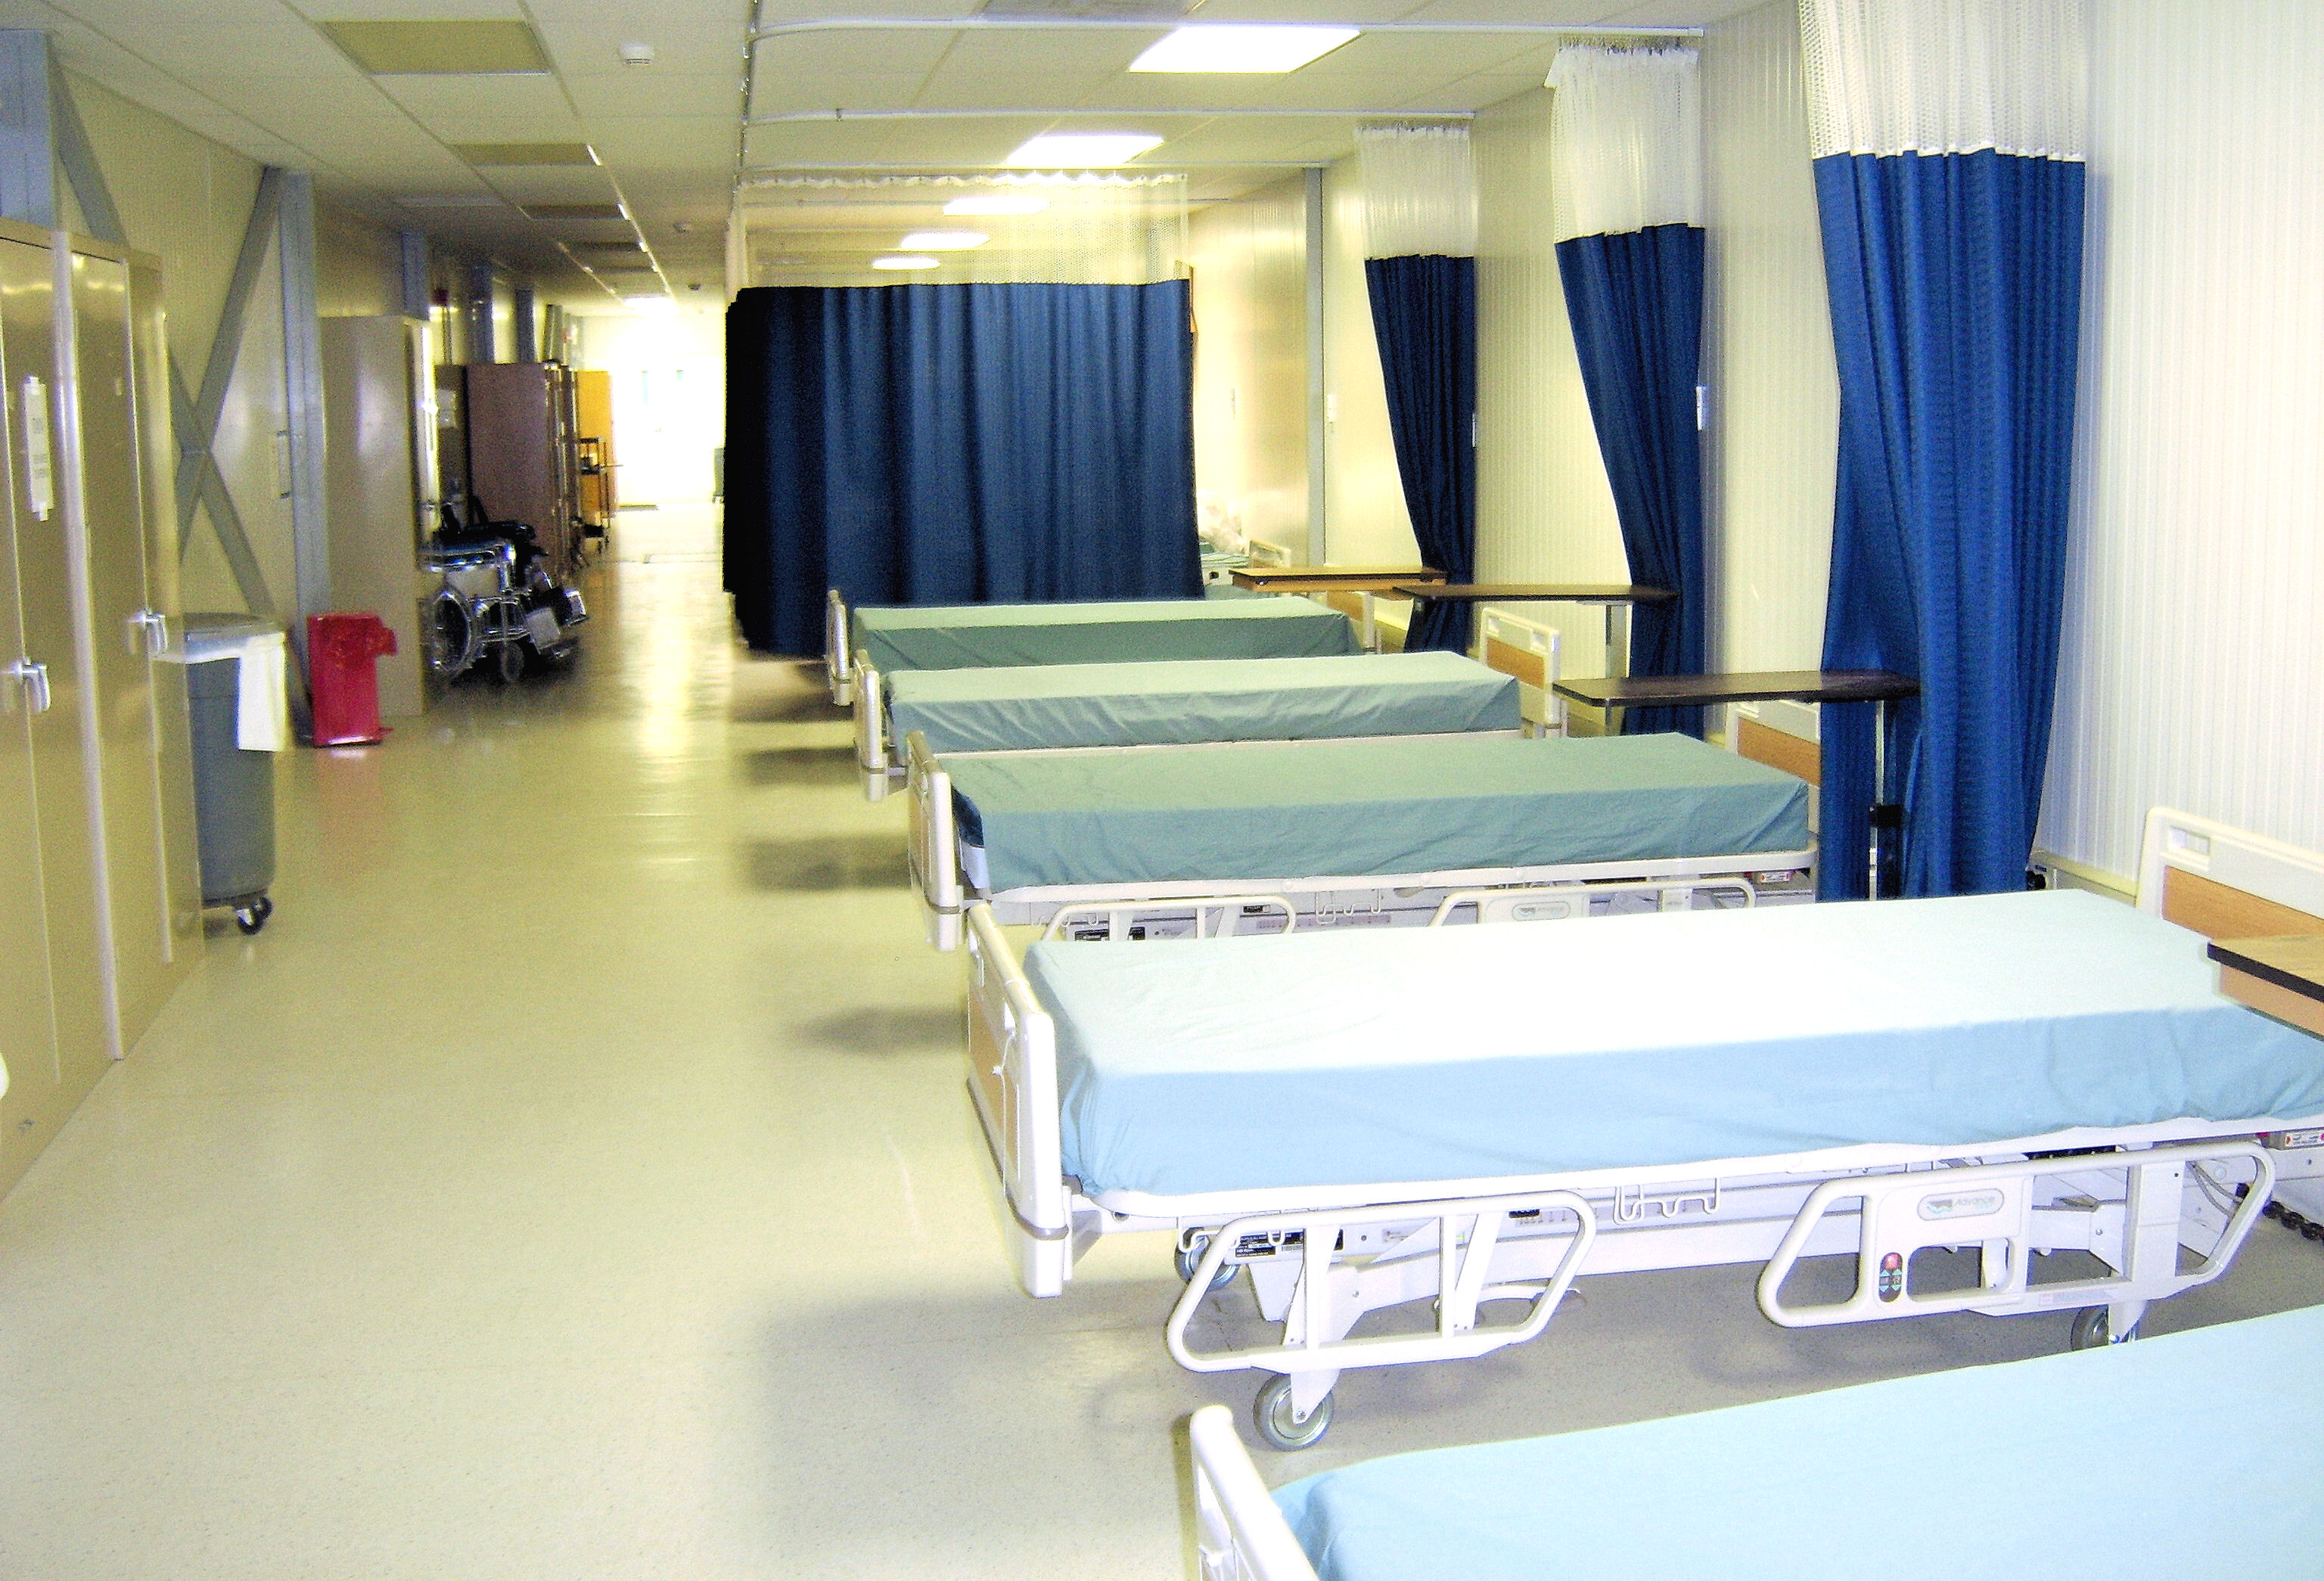

Slide 21
SCENE 7 realisation

Slide 22
moral

